Slide 1
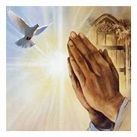
The Lord’s Prayer
Psalm 23 * King James Version
23 The Lord is my shepherd; I shall not want.
² He maketh me to lie down in green pastures: he leadeth me beside the still waters.
³ He restoreth my soul: he leadeth me in the paths of righteousness for his name's sake.
⁴ Yea, though I walk through the valley of the shadow of death, I will fear no evil: for thou art with me; thy rod and thy staff they comfort me.
⁵ Thou preparest a table before me in the presence of mine enemies: thou anointest my head with oil; my cup runneth over.
⁶ Surely goodness and mercy shall follow me all the days of my life: and I will dwell in the house of the Lord for ever.

Slide 2
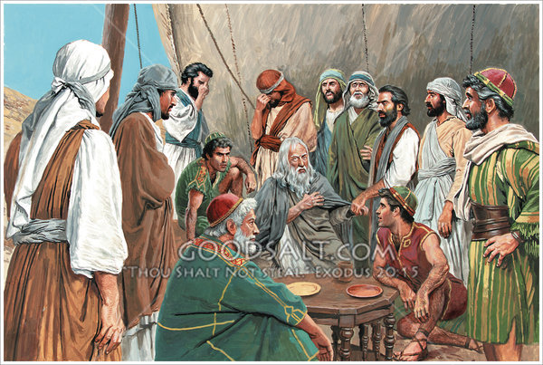
Jacob’s Sons
Leah gives birth to
Reuben, (2) Simeon, (3) Levi, and (4) Judah.
Then Rachel gives Bilhah, her servant girl to Jacob, “so that she may give birth on my behalf” (Genesis 30:3). Bilhah bore
(5) Dan and (6) Naphtali.
When Leah realized she ceased bearing Jacob’s sons (for the moment), she gave her servant, Zilpah to Jacob and she bore him
(7) Gad and (8) Asher.
After this, Leah again conceived (twice) and gave birth to
(9) Issachar and (10) Zebulun.
Rachel finally received the blessing of conception (God has taken away my reproach—Genesis 30:23) and gave birth to
(11) Joseph
(12) Benjamin, whom she bore as she died.

Slide 3
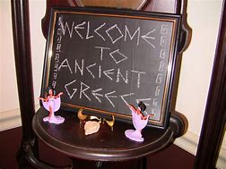
Greek Alphabet
13. Nu
14. Xi
15. Omicron
16. Pi
17. Rho
18. Sigma
19. Tau
20. Upsilon
21. Phi
22. Chi
23. Psi
24. Omega
1. Alpha
2. Beta
3. Gamma
4. Delta
5. Epsilon
6. Zeta
7. Eta
8. Theta
9. Iota
10. Kappa
11. Lambda
12. Mu

